Slide 1




Week-3 (Discussion)
11th Feb, 2025
Deep Learning
Prof. Sudarshan Iyenger
Professor and Head of the Department
Department of Computer Science and Engineering
IIT Ropar
Ayan Paul
PMRF Research Scholar
IIT Kharagpur

Slide 2
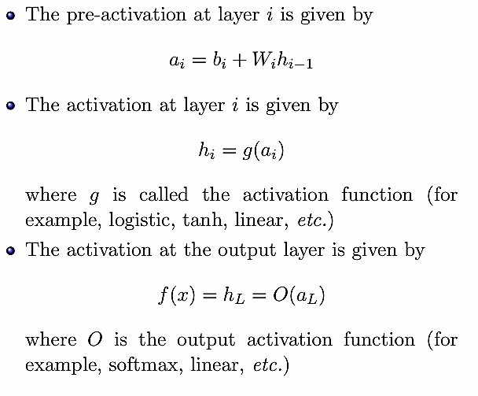
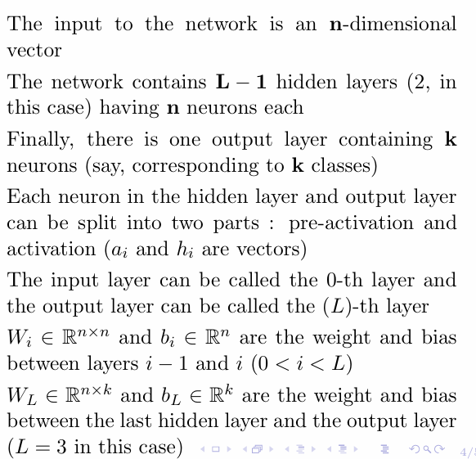
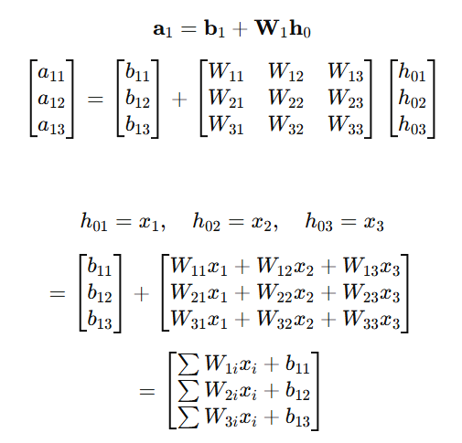
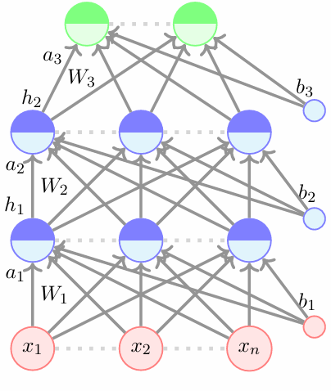
Feedforward Neural Networks (a.k.a.
Multilayered Network of Neurons)

Slide 3
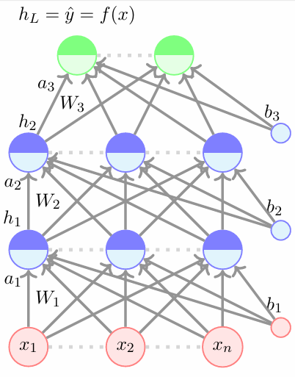
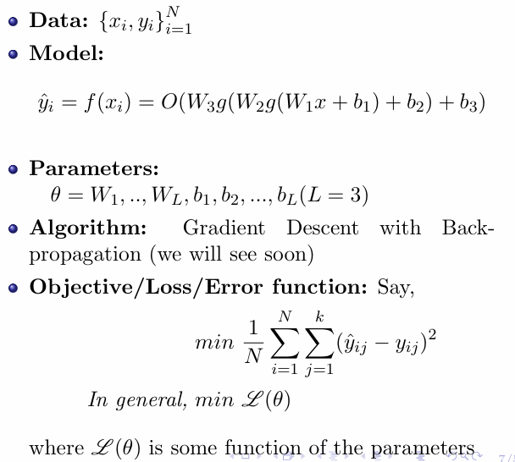
Components of Supervised Learning

Slide 4
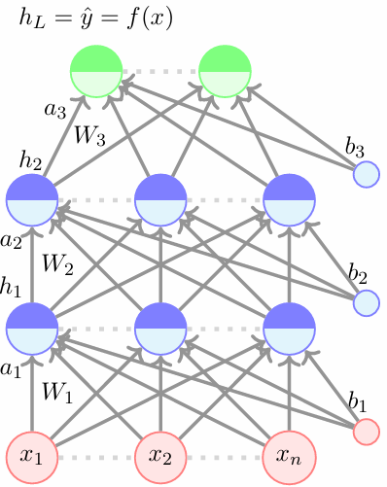
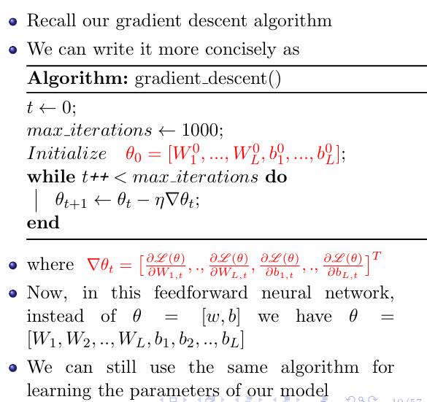
Learning Parameters of Feed forward Neural Networks

Slide 5
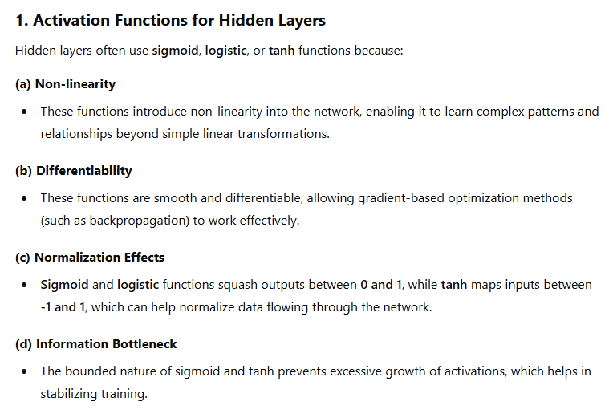
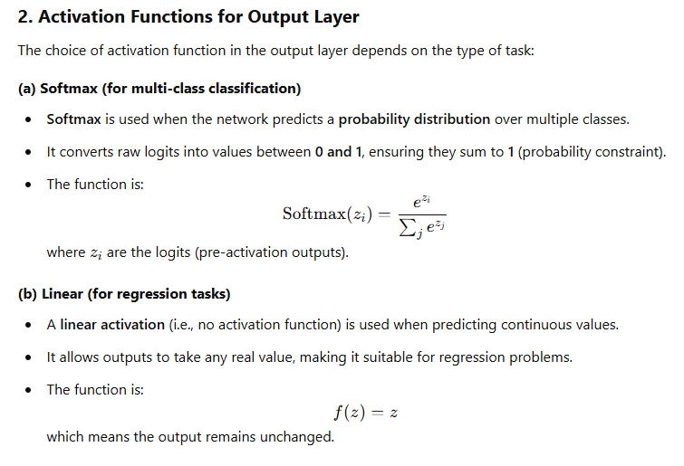
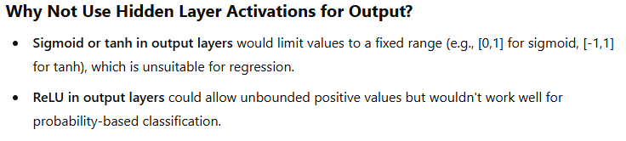
Choice of Activation function for Different Layers

Slide 6
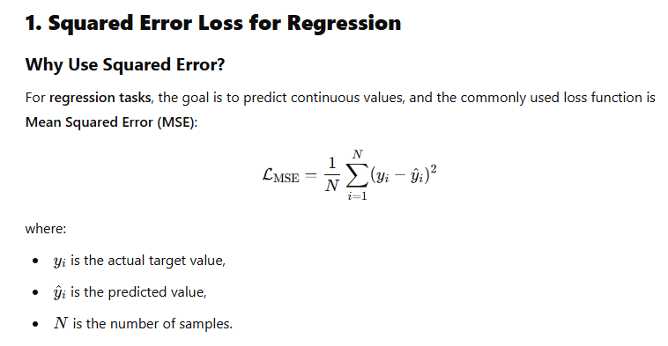
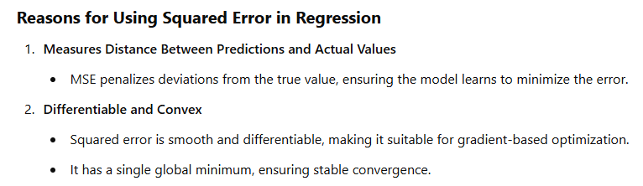
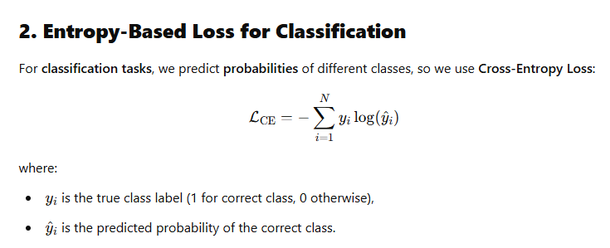
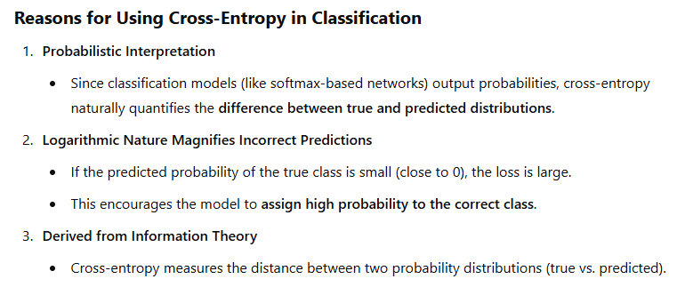
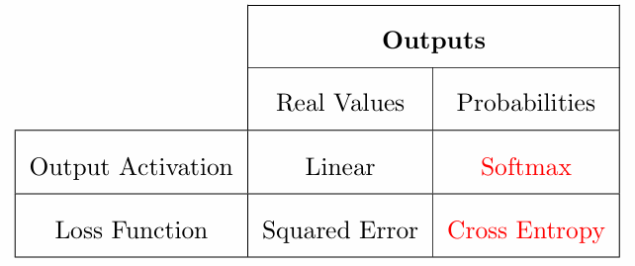
Choice of Loss function

Slide 7
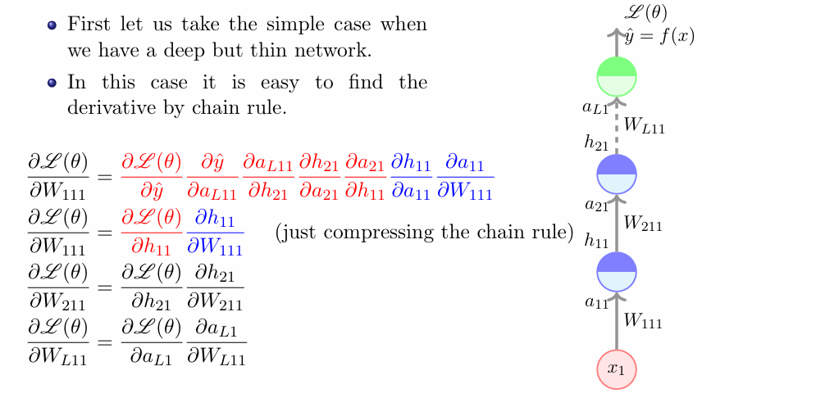
Back-Propagation Intitution

Slide 8
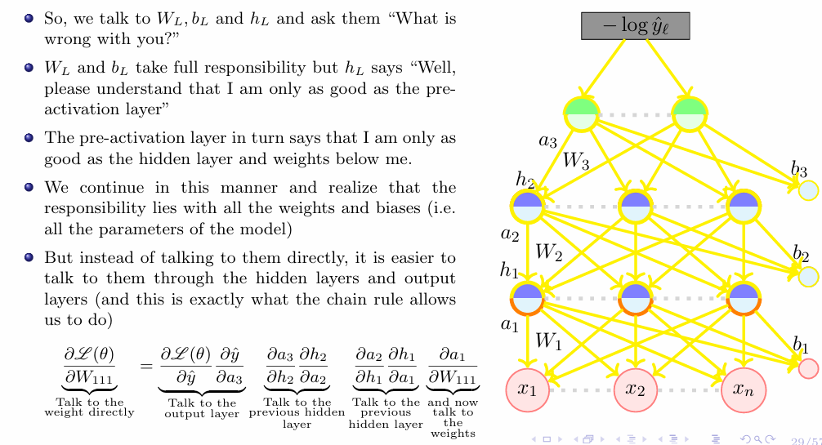
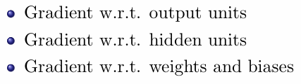

Slide 9
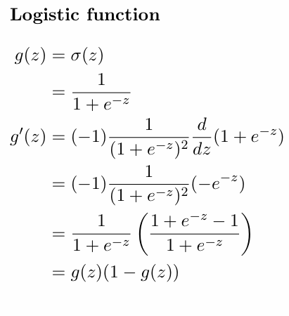
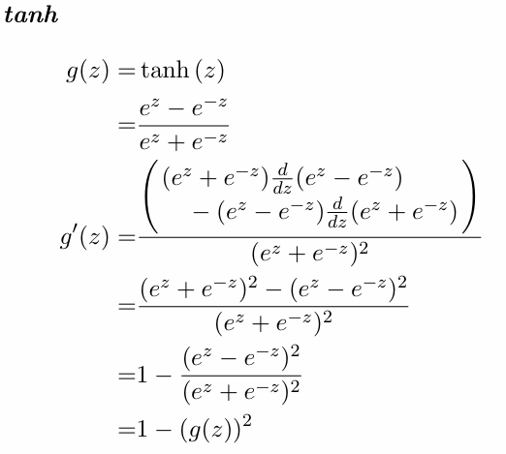
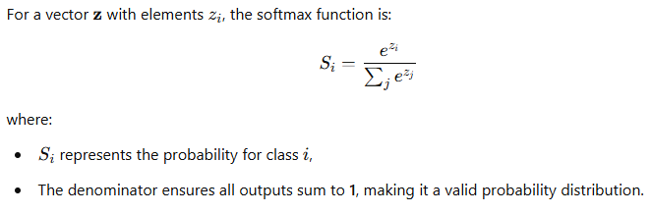
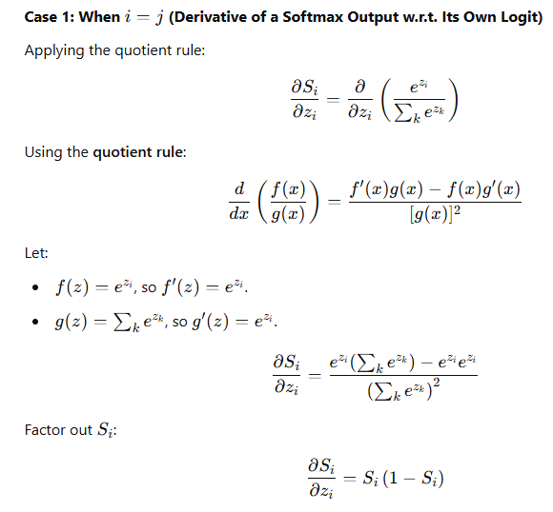
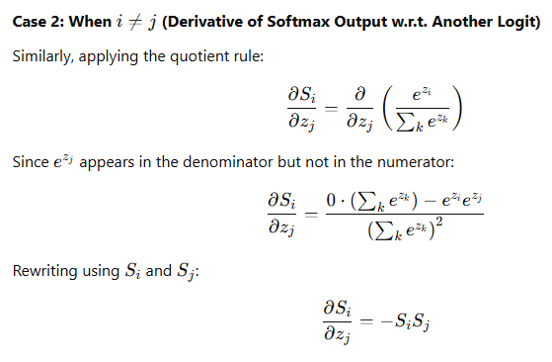
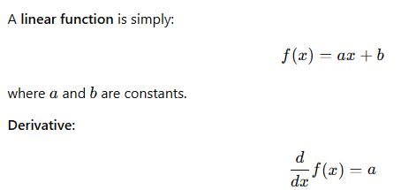
Derivative of the activation function for hidden and output layers
SoftMax function
Linear function

Slide 10
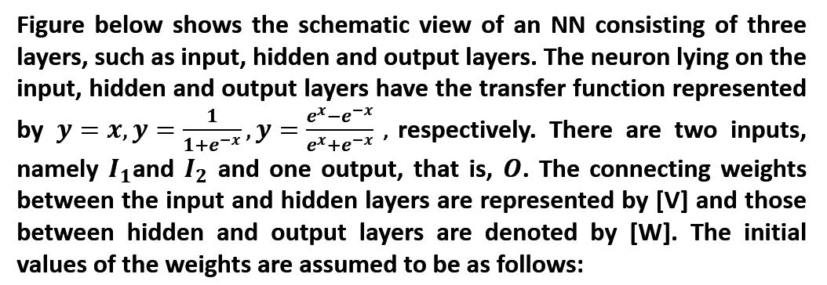
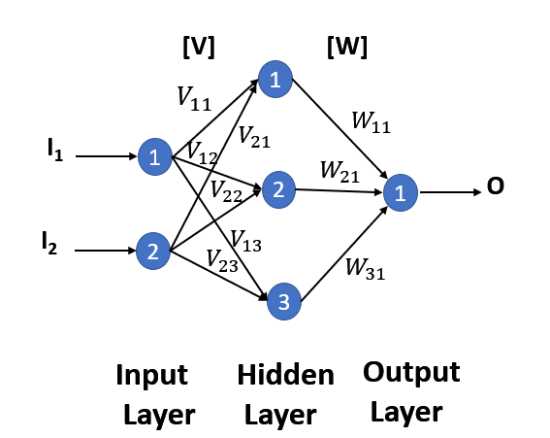
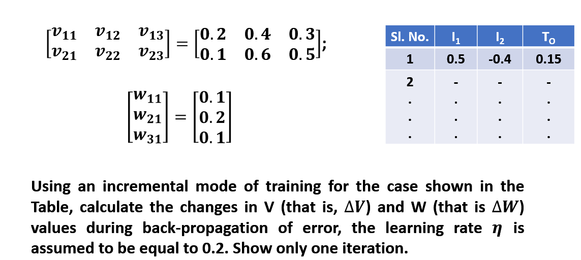
Numerical Example

Slide 11
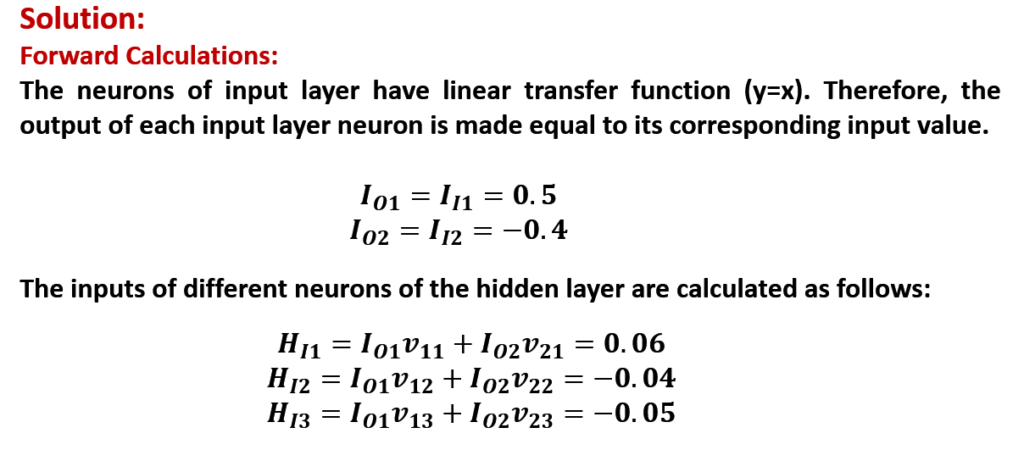
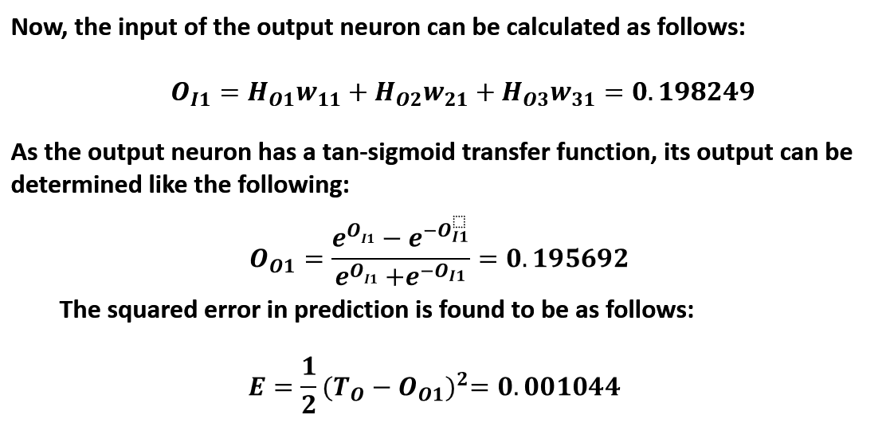
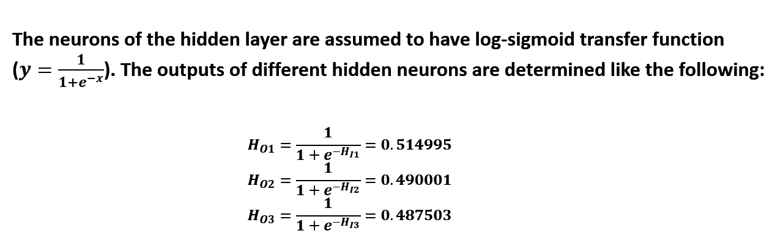

Slide 12
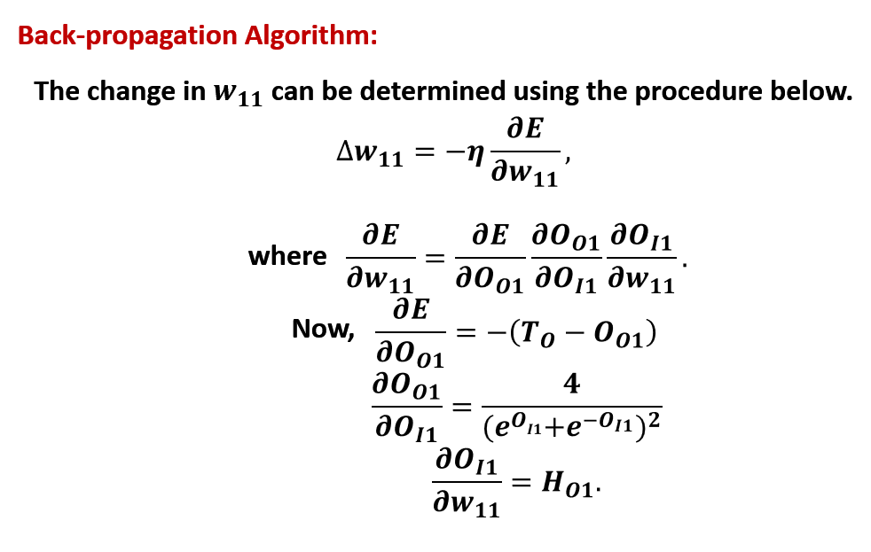
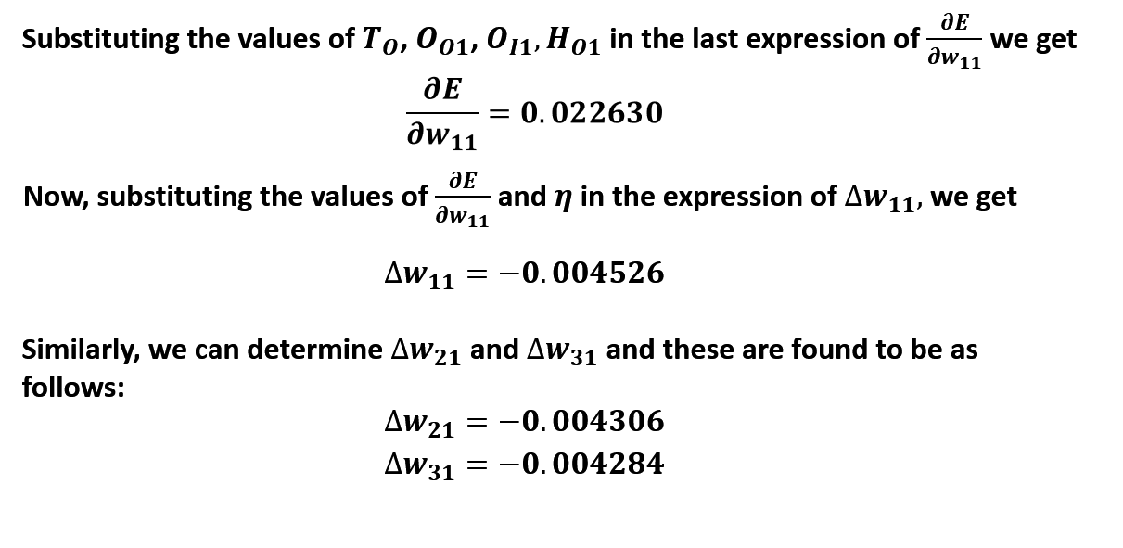

Slide 13
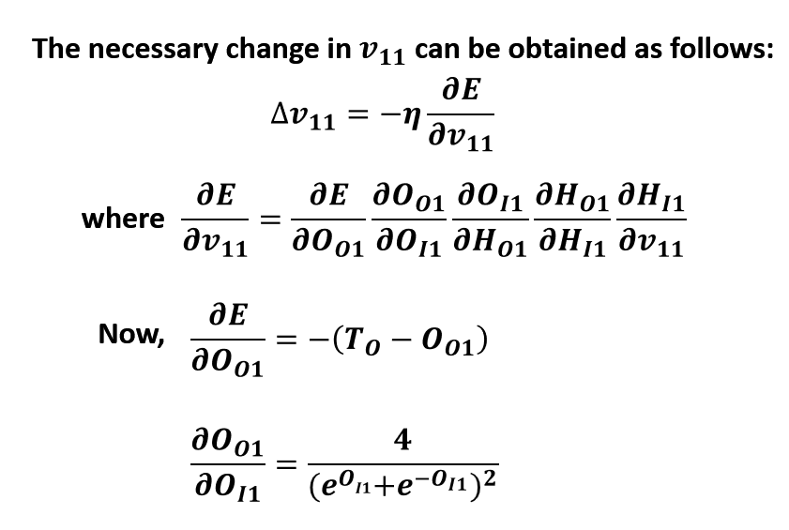
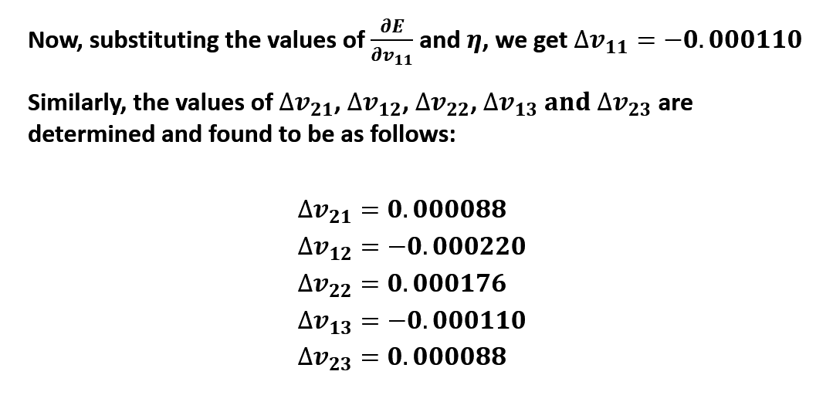
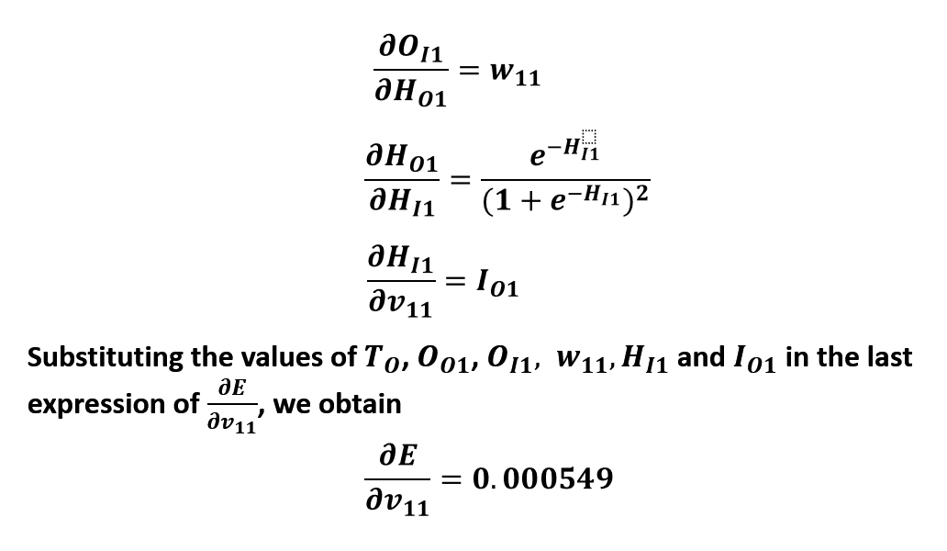

Slide 14
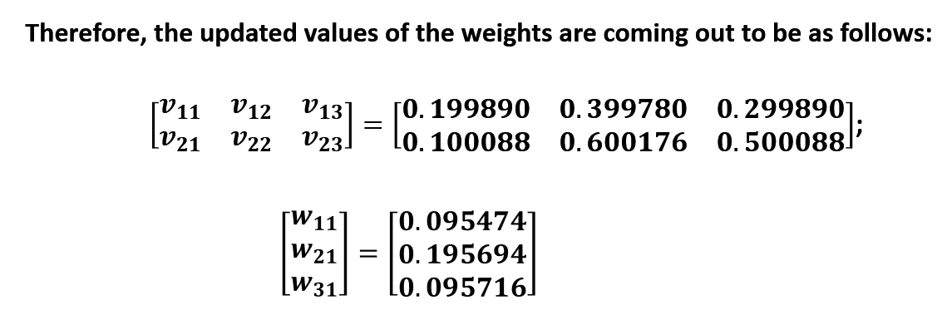

Slide 15
Topics on which Week 3 Assignment Questions are based
Feedforward Neural Networks
Learning Parameters
Choice of Activation function at different layers
Choice of Loss function
Back-Propagation

Slide 16
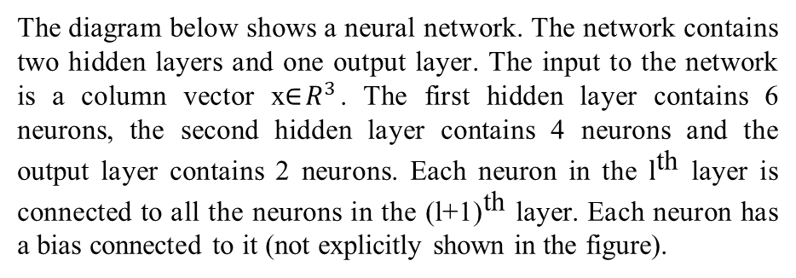
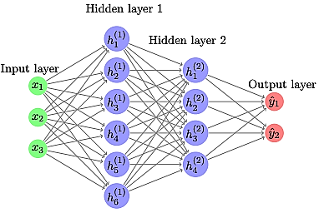
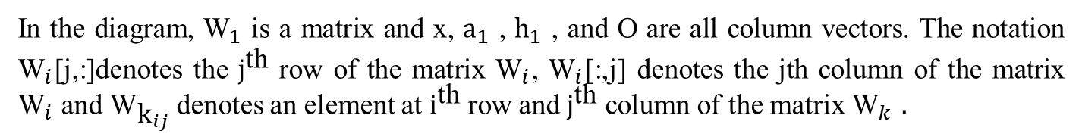
Use the following data to answer the questions 1 to 3

Slide 17
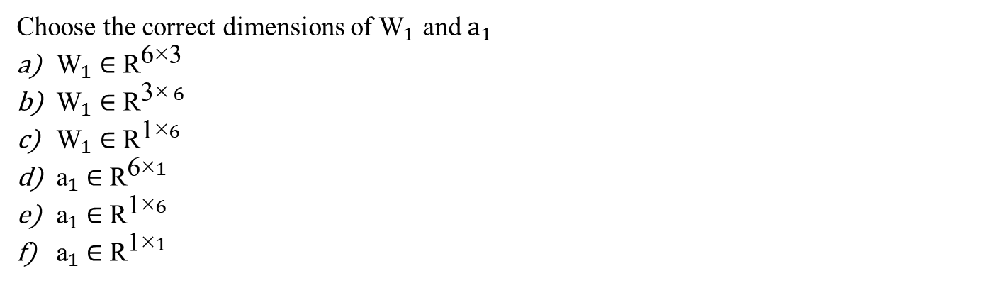
QUESTION 1
SOLUTION 1
CORRECT ANSWER 1
a), d)

Slide 18
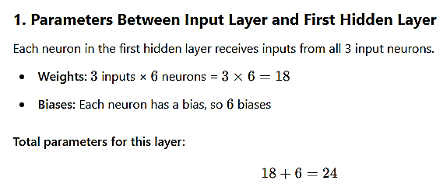
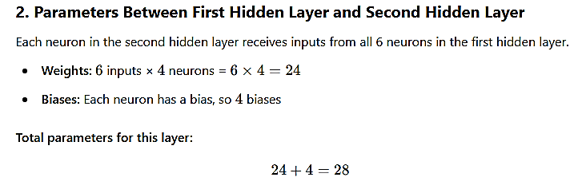
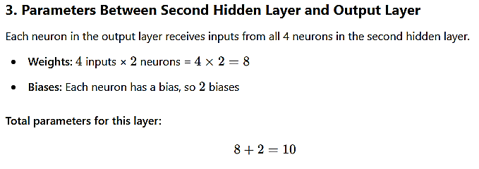
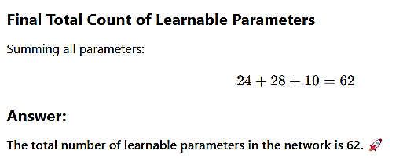
QUESTION 2
How many learnable parameters(including bias) are there in the network?
SOLUTION 2
CORRECT ANSWER 2
62

Slide 19
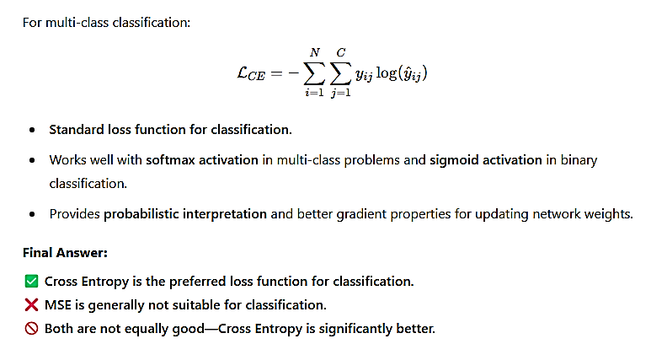
QUESTION 3
Which of the following loss functions is preferred for the classification problem?
Means Squared error
Cross entropy
Both Mean Squared Error and Cross Entropy loss can be used
SOLUTION 3
CORRECT ANSWER 3
b)

Slide 20
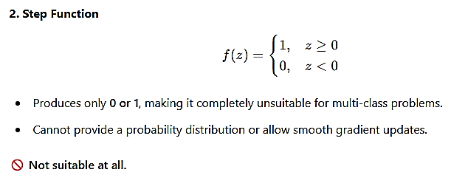
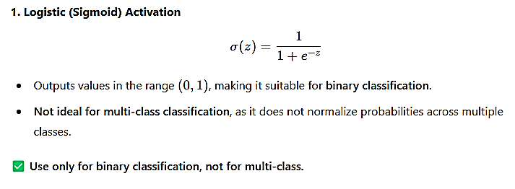
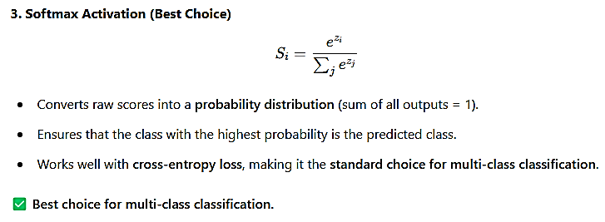
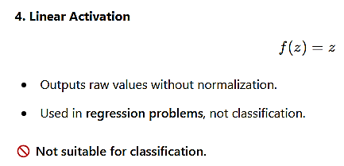
QUESTION 4
We have a multi-classification problem that we decide to solve by training a feedforward neural network. What activation function should we use in the output layer to get the best results?
Logistic
Step function
Softmax
linear
SOLUTION 4
CORRECT ANSWER 4
c)

Slide 21



QUESTION 5
We have data x with the following labels y = [‘car’, ‘bus’, ‘bike’, ‘car’, ‘bus’, ‘car’, ‘bus’, ‘bike’, ‘car’]. Which of the following distribution will give the lowest cross-entropy loss with y? (Distribution is given in the following order [‘car’, ‘bus’,‘bike’])?
[0.49,0.30,0.21]
[0.44,0.33,0.22]
[0.50,0.30,0.20]
[0.44,0.39,0.19]
SOLUTION 5
CORRECT ANSWER 5
b)

Slide 22

QUESTION 6
Which of the following statements about backpropagation is true?
It is used to compute the output of a neural network.
It is used to initialize the weights in a neural network.
It is used to optimize the weights in a neural network.
It is used to regularize the weights in a neural network.
SOLUTION 6
CORRECT ANSWER 6
c)

Slide 23

QUESTION 7
Given two probability distributions p and q, under what conditions is the cross entropy between them minimized?
All the values in p are lower than corresponding values in q
All the values in p are lower than corresponding values in q
p=0(0 is a vector)
p=q
SOLUTION 7
CORRECT ANSWER 7
d)

Slide 24



QUESTION 8
Given that the probability of Event A occurring is 0.80 and the probability of Event B occurring is 0.20, which of the following statements is correct?
Event A has a low information content
Event A has a high information content
Event B has a low information content
Event B has a high information content
SOLUTION 8
CORRECT ANSWER 8
a), d)

Slide 25



Use the following data to answer the questions 9 and 10
The following network doesn't contain any biases and the weights of the network are given below:

Slide 26



QUESTION 9
What is the predicted output for the given input x after doing the forward pass?
SOLUTION 9
CORRECT ANSWER 9
Range: 4.95 to 4.96

Slide 27

QUESTION 10
Compute and enter the loss between the output generated by input x and the true output y
SOLUTION 10
CORRECT ANSWER 10
Range: 9.30 to 9.31

